Slide 1


Pycaret -Library
Moez Ali (Creator of Pycaret)
Mid-Term Project
ABHIJEET CHOUDHARI- MSBA’24

Slide 2

Why PyCaret ?
It exponentially speeds up the experiment cycle and makes you more productive with big-data analytics and the decision-making process for CITIZEN DATA SCIENTIST
How?
open-source, low-code
machine learning library in Python
Automation of end-to-end Workflow
Python wrapper around several machine learning libraries and frameworks, such as sci-kit-learn, XG Boost, Light GBM,etc
PyCaret is an alternate low-code library that can be used to replace hundreds of lines of code with a few lines only. This makes experiments exponentially fast and efficient.
Notes:
Source: https://pycaret.gitbook.io/docs
Dataset: https://github.com/pycaret/datasets/blob/main/meta/common/index.csv

Slide 3
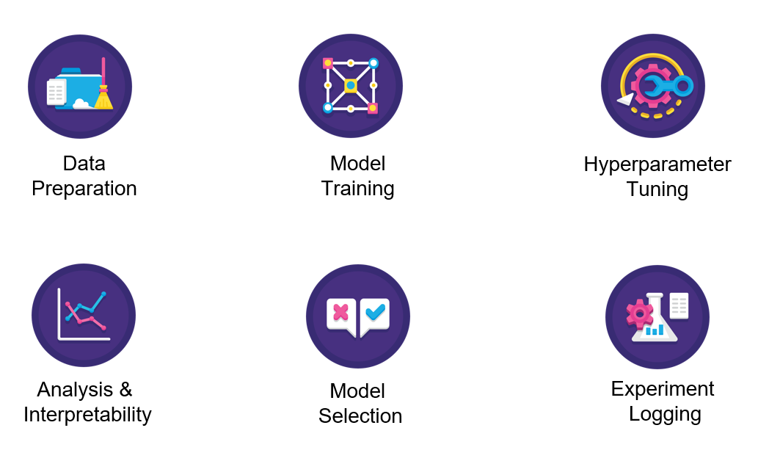
What is the ML Life Cycle?
Notes:
Source: https://pycaret.gitbook.io/docs

Slide 4
Machine Learning use-cases supported in PyCaret
Classification
Regression
Time Series
Clustering
Anomaly Detection

Slide 5
Regression Module-Use Case
ML Problem Statement: Regression model on Insurance Premium prediction- Supervised Learning
Functions Used as Python Code
Setup the data for Model development
#from pycaret.regression import *
# s = setup(data, target = 'charges', session_id = 145, log_experiment= True, normalize= True, experiment_name= 'insuranceRun’)
compare baseline models
# best = compare_models()
check ML logs
#InsuranceLog = get_logs()
#pull()
Tune the best model among all
# tunemodel = tune_model(best)
Analyze the best model for the performance using charts
# plot model(best, plot = 'residuals’)
Predict on the test set
# holotype = predict_model(best)
Save the Model and Experiment
#save_model(best, 'my_first_pipeline’)
#save_experiment('insuranceRun')

Slide 6
Clustering Module-Use Case
ML Problem Statement: Identify the clusters on the Jewelry dataset to segment the customer profile
Functions Used as Python Code
Setup the data for Model development
# from pycaret.clustering import *
# s = setup(data_train, session_id = 123, log_experiment= True, normalize= True)
Create Model
# kmeans = create_model('kmeans’)
# kmeans2 = create_model('ap')
Evaluate the Model
Cluster = 4
# Evaluate_model(kmeans)
Cluster = 5
# evaluate_model(kmeans3)
Using Affinity Propagation algorithms
# evaluate_model(kmeans2)
Assigned Model
# kmeans_cluster = assign_model(kmeans3)
# kmeans_cluster
Analyse the model
# plot pca cluster plot
plot_model(kmeans3, plot = 'cluster')
# plot elbow
plot_model(kmeans3, plot = 'elbow')
Prediction
predict on the test set
kmeans_pred = predict_model(kmeans3, data=data_test)
kmeans_pred
Save the Model pipeline
save_model(kmeans3, 'saved_kmeans_model')
Log experiments completed for the building of the model
logF = get_logs()
print(logF)
pull()

Slide 7
Sources
https://pycaret.org/
https://pycaret.gitbook.io/docs/learn-pycaret/
https://www.moez.ai/

Slide 8

Thank you

